Slide 1
DevOps Culture, Principles, and Toolchains
COMP6100001 - Software engineering
Session 24
Kenny Jingga, S.Kom., M.T.

Slide 2
Session 24 – DevOps Culture, Principles, and Toolchains
Learning objectives
At the end of this session, students will be expected to be able to:
Define DevOps and its goals within modern software development.
Understand the cultural shift required to bridge development and operations.
Explore core DevOps principles: automation, CI, CD, and continuous deployment.
Recognize the benefits of DevOps practices.
Analyze case studies on successful DevOps implementation.
Discuss common challenges in DevOps adoption and potential solutions.

Slide 3
Session 24 – DevOps Culture, Principles, and Toolchains
Content outline
DevOps overview & goals
Cultural shift (Dev + Ops collaboration)
DevOps principles (automation, CI, CD)
DevOps toolchains
Benefits & challenges
Case studies & best practices

Slide 4
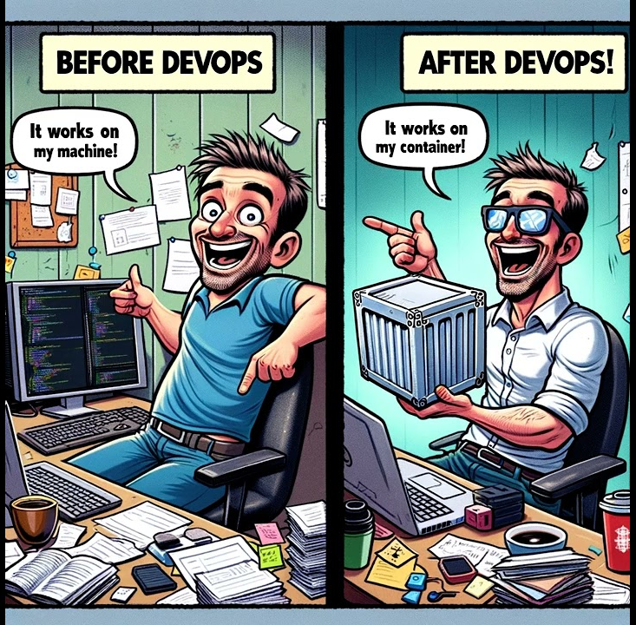
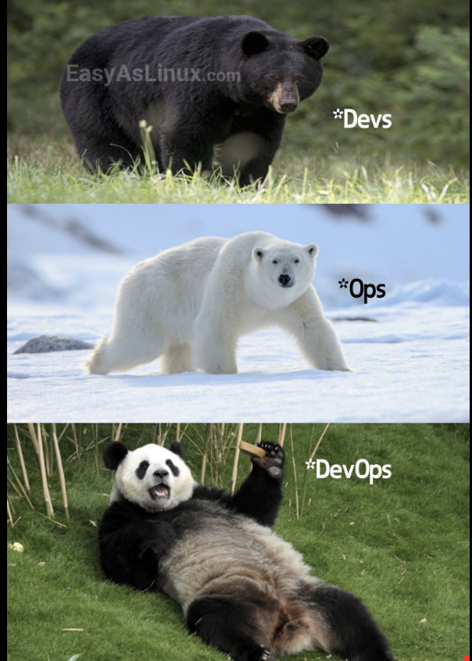
The DevOps

Slide 5
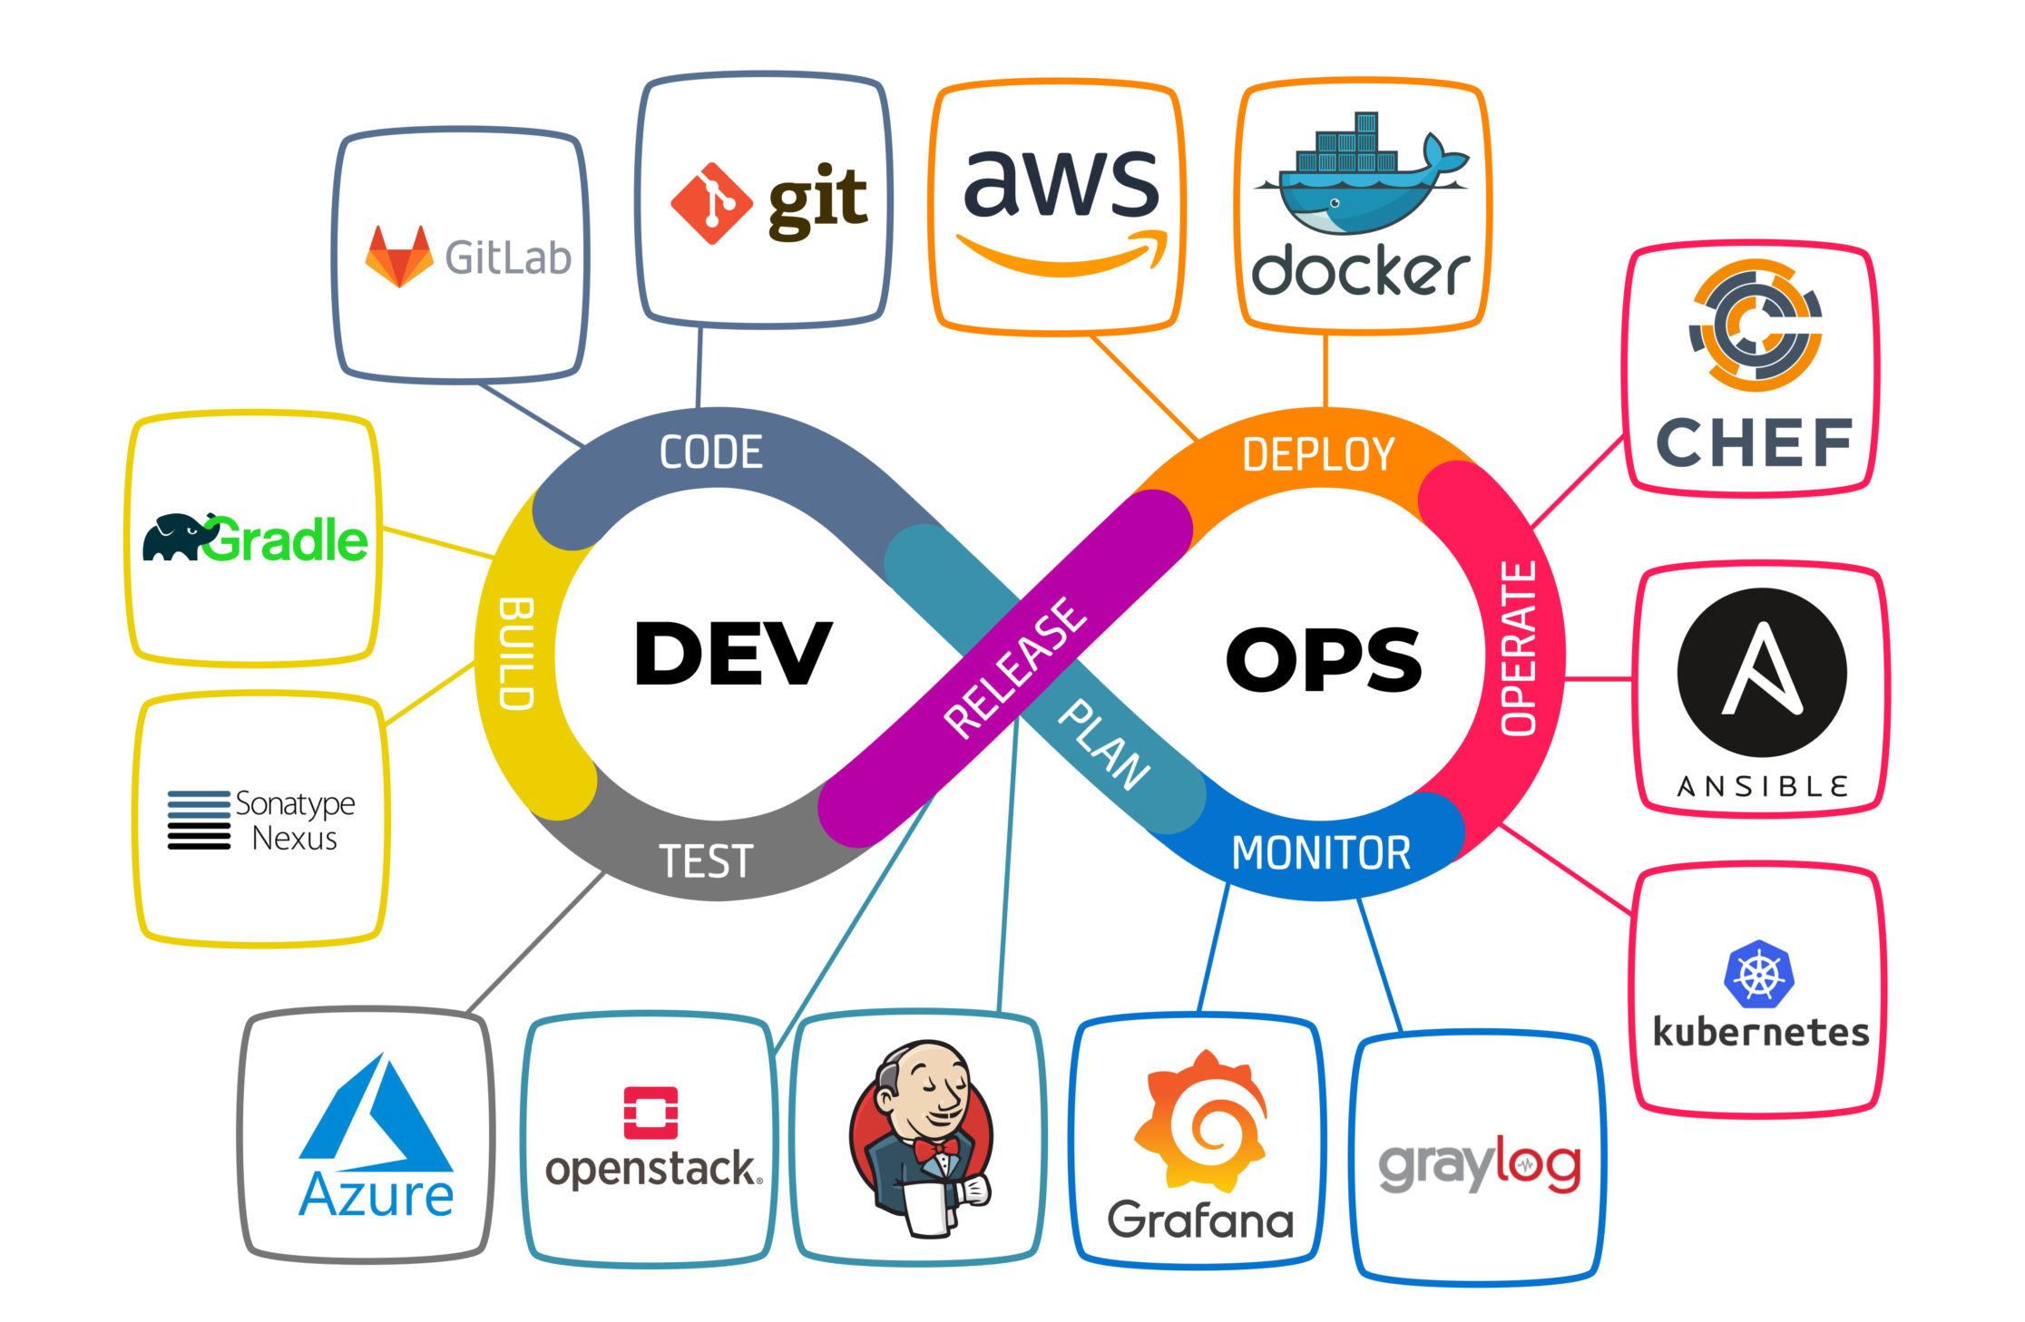
Definition and Goals of Devops
Definition of DevOps
DevOps is a set of practices, principles, and cultural philosophies aimed at unifying software development (Dev) and IT operations (Ops).
Focuses on collaboration, automation, and feedback loops to deliver high-quality software at speed.

Slide 6
Definition and Goals of Devops
Goals of DevOps
Faster Delivery: Streamlining the release process to deliver new features and fixes rapidly.
Improved Quality: Ensuring code is robust and reliable through automation and consistent feedback.
Efficiency and Reduced Bottlenecks: Removing silos between Dev and Ops to improve workflow efficiency.
Customer Satisfaction: Enhancing the user experience by quickly addressing customer needs.

Slide 7
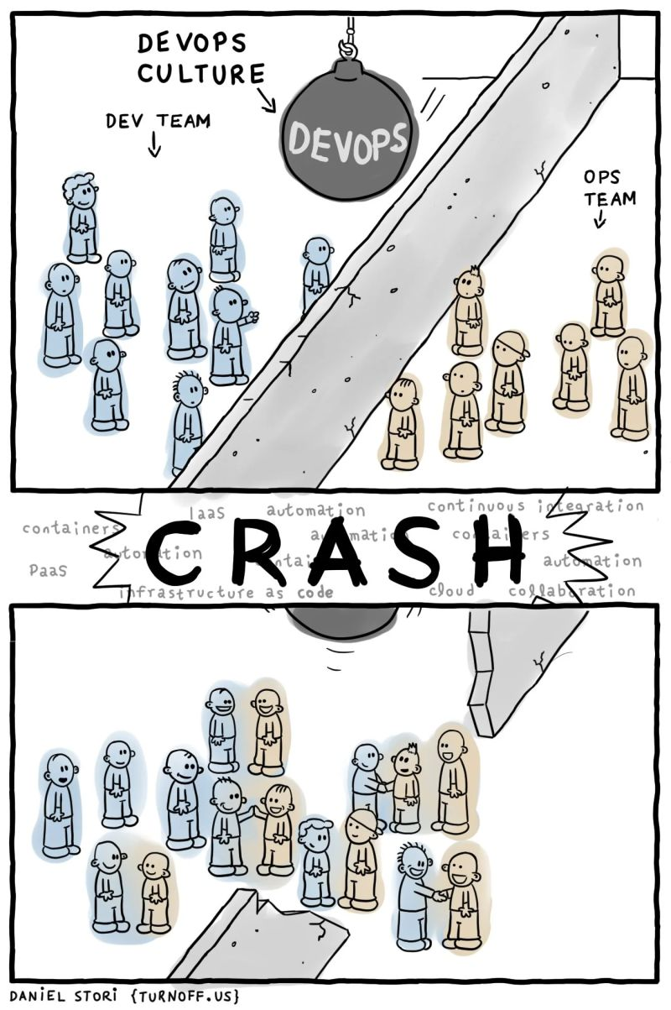
Cultural Shift: Collaboration between Development and Operations
Traditional vs DevOps Culture
In traditional models, development and operations work separately, leading to miscommunication and delays.
DevOps advocates for shared responsibilities and joint efforts throughout the software lifecycle.

Slide 8
Cultural Shift: Collaboration between Development and Operations
Key Aspects of Devops Culture
Collaboration and Communication: Encourages daily stand-ups, shared tools, and cross-functional teams.
Empowerment and Ownership: Developers are involved in deploying and monitoring code in production.
Blameless Postmortems: A culture where errors are analyzed constructively to learn and improve.

Slide 9
Devops Principles
Automation
Automates repetitive tasks, reducing human error and speeding up processes.
Example: Using scripts to automate testing, deployment, and infrastructure setup.

Slide 10
Devops Principles
Continuous Integration (CI)
Developers frequently merge code changes into a shared repository where automated tests validate the changes.
Example: GitHub Actions or Jenkins running automated tests on every code commit.

Slide 11
Devops Principles
Continuous Delivery (CD)
Extends CI by ensuring the code is always ready to be deployed to production.
Example: Staging environment where validated builds are automatically deployed and await approval for production.

Slide 12
Devops Principles
Continuous Deployment
Automates the release of validated code to production without manual intervention.
Example: An e-commerce platform using continuous deployment to release minor feature updates directly to production.

Slide 13
Benefits of Adopting DevOps Practices
The Benefits
Increased Deployment Frequency:
  Frequent releases enable rapid iterations, improving customer satisfaction.
Reduced Failure Rate:
  With automated testing and CI/CD pipelines, issues are identified and resolved quickly, lowering error rates.
Faster Time-to-Market:
  Automation and streamlined processes speed up feature development and deployment.
Improved Team Morale:
  Collaboration and shared responsibility foster a culture of trust and team cohesion.
Example: Netflix, a notable adopter of DevOps, continuously deploys updates to its streaming platform with minimal downtime, improving user experience and satisfaction.

Slide 14
Case Studies on Successful DevOps Implementations
Several Cases on Notable Industries
Netflix:
  As a leader in DevOps, Netflix uses continuous deployment and automation to handle vast user traffic with minimal disruption.
  Key Practices: Chaos Engineering, automated testing, microservices architecture.
Amazon:
  Amazon’s DevOps practices allow it to deploy code to production every 11.7 seconds on average.
  Key Practices: CI/CD pipeline, automated monitoring, infrastructure as code (IaC).
Etsy:
  Adopted DevOps to recover from a slow deployment process; now, they deploy multiple times a day with improved quality and fewer rollback needs.
  Key Practices: Continuous deployment, blameless culture, collaborative DevOps teams.

Slide 15
Challenges and Solutions in DevOps Adoption
Common Challenges
Cultural Resistance: Teams accustomed to traditional models may resist DevOps changes.
Skills Gap: Requires proficiency in automation, CI/CD, and infrastructure as code.
Tooling Complexity: Integrating and maintaining multiple DevOps tools can be overwhelming.
Security Concerns: Rapid releases and automation require strict security protocols to avoid vulnerabilities.

Slide 16
Challenges and Solutions in DevOps Adoption
Solutions and Best Practices
Gradual Adoption: Implement DevOps in phases, starting with CI and automation.
Training and Upskilling: Provide team members with resources to develop DevOps skills.
Clear Communication: Foster collaboration between departments through open dialogue and shared goals.
Security Integration (DevSecOps): Embed security into the DevOps pipeline to automate security checks.

Slide 17
Activities and Discussion
Group Discussion:
  Discuss a scenario where DevOps could improve a given software project (e.g., mobile app development for a small startup) and identify which practices they would implement first and why.
Case Analysis Exercise:
  Review a case study, such as Netflix’s use of Chaos Engineering, to explore how DevOps tools and culture enhance reliability and performance.

Slide 18
Overview of DevOps Toolchains
Definition and Purpose of DevOps Toolchains
Definition of a DevOps Toolchain:
  A DevOps toolchain is a set of tools that automate and streamline the development, testing, integration, and deployment processes. It covers the software lifecycle from coding to monitoring in production.
Purpose of a DevOps Toolchain:
  Enhances collaboration between teams, reduces errors, accelerates deployment, and supports continuous integration and deployment.

Slide 19
Overview of DevOps Toolchains
Components of a Typical Toolchain
Planning Tools: Track requirements and manage workflows (e.g., Jira).
Version Control Tools: Manage code versions (e.g., Git).
Build and CI/CD Tools: Automate testing, integration, and deployment (e.g., Jenkins).
Monitoring and Logging Tools: Observe system health and analyze logs (e.g., Prometheus).
Example: A retail company’s toolchain includes Git for version control, Jenkins for CI/CD, Docker for containerization, and Grafana for monitoring performance.

Slide 20
Continuous Integration Tools
Jenkins and Travis CI
CI automates the process of integrating code changes frequently and testing them to catch issues early.
Jenkins:
  Features: Open-source, extensive plugin library, customizable pipelines.
  Use Case: Automating test runs on code commits to ensure stability.
  Example: Running unit tests and code quality checks on each commit to GitHub.
Travis CI:
  Features: Cloud-based CI tool with GitHub integration, easy configuration via .travis.yml.
  Use Case: Automating build and test processes for open-source projects.
  Example: Automatically testing and deploying a Node.js application to a staging environment.

Slide 21
Continuous Deployment Tools
Spinnaker and GoCD
CD automates the deployment process, pushing validated code to production without manual intervention.
Spinnaker:
  Features: Multi-cloud deployment support, pipelines for release management.
  Use Case: Deploying applications across cloud platforms like AWS and Google Cloud.
  Example: A microservices architecture deploying independently to AWS and Kubernetes clusters.
GoCD:
  Features: Visual pipeline modeling, supports multiple deployment environments.
  Use Case: Setting up CD pipelines with stages for testing, staging, and production.
  Example: A Java application deploying from a development environment to production through GoCD pipelines.

Slide 22
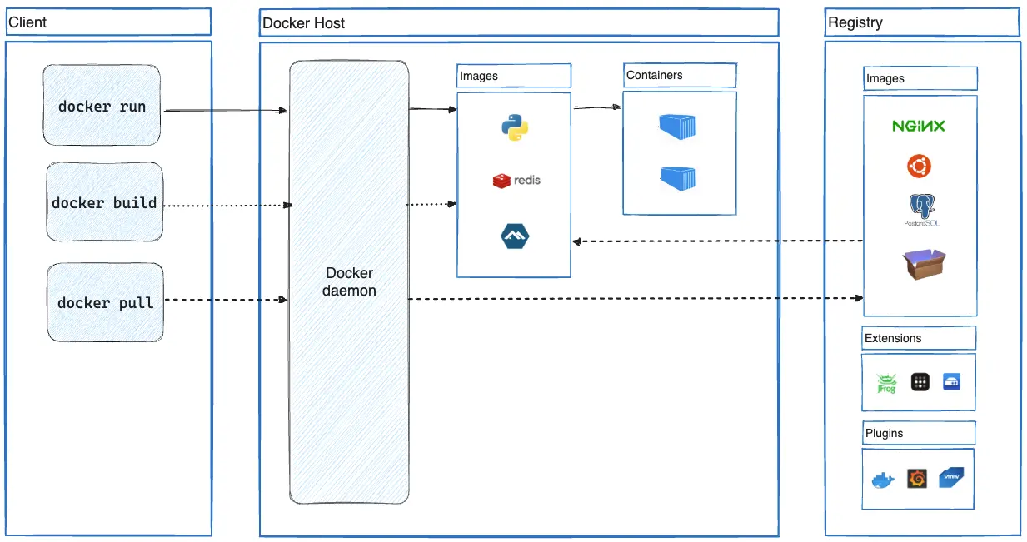
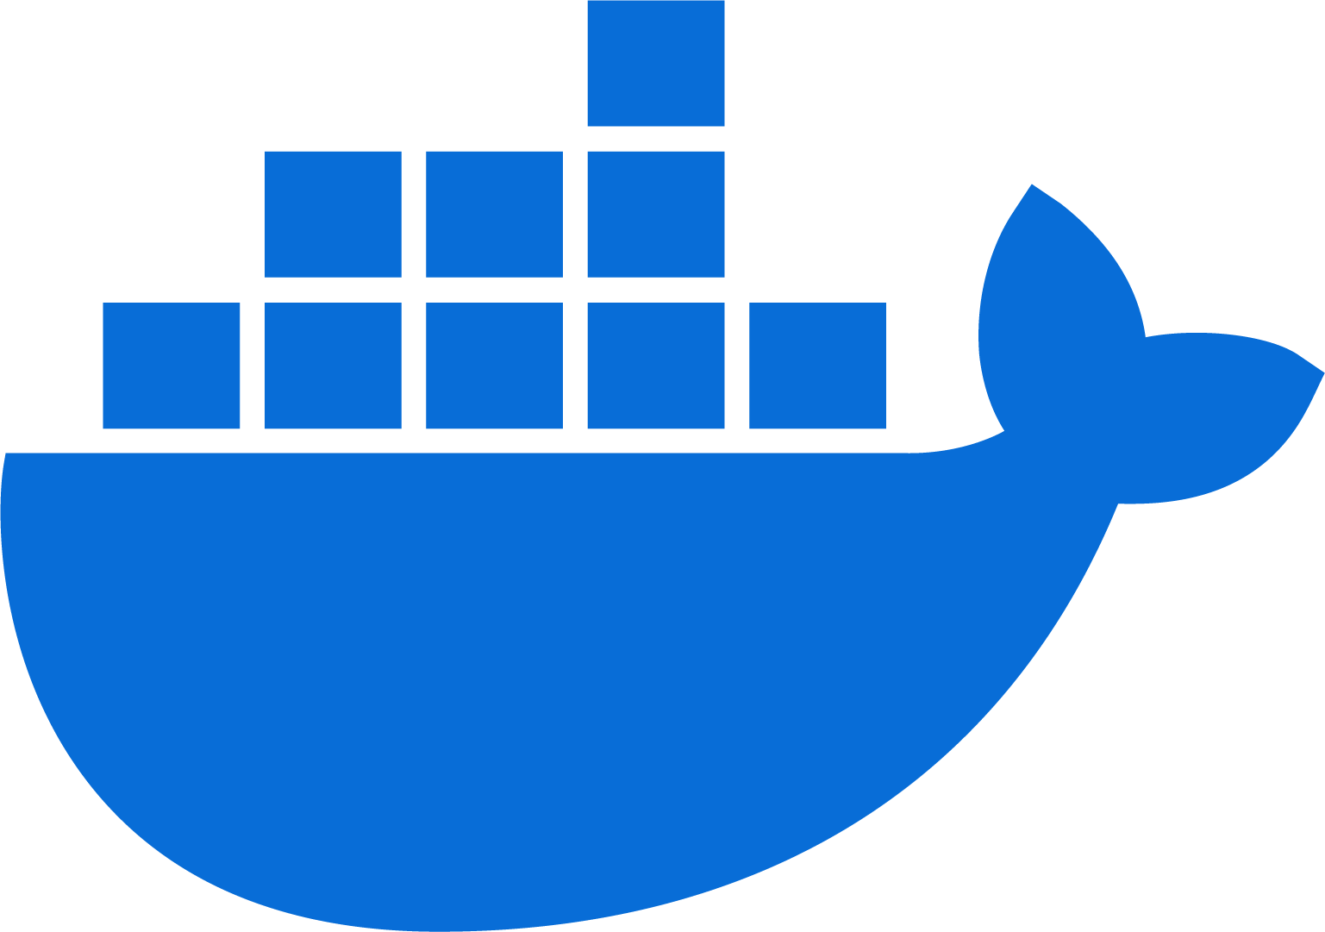
Containerization and Orchestration
Containerization with Docker
Docker packages applications into containers, enabling consistency across environments.
Benefits: Environment consistency, easy scaling, and efficient resource use.
Example: Packaging a Python application in a Docker container to run identically on different servers.

Slide 23
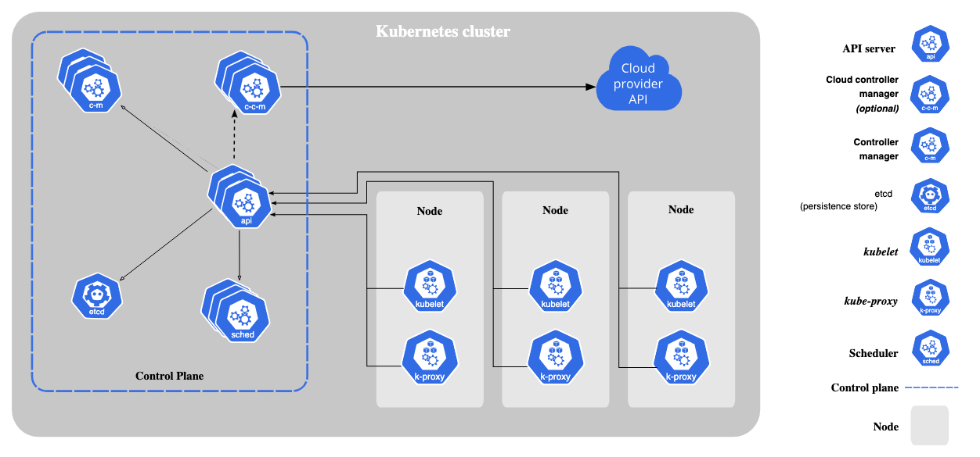
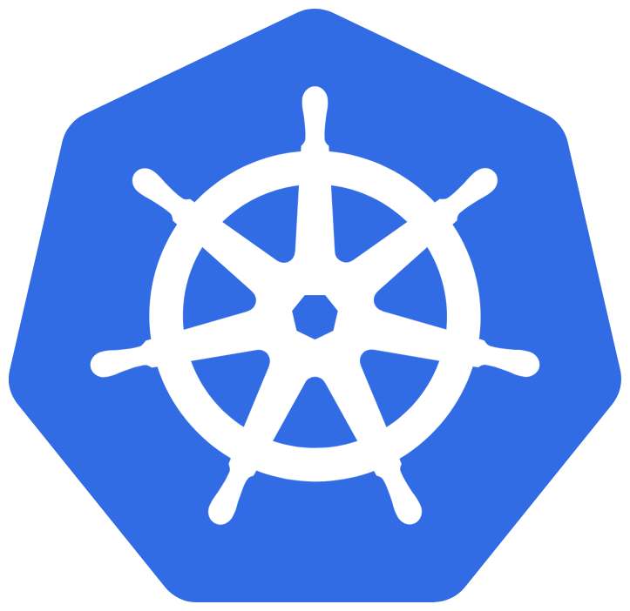
Containerization and Orchestration
Orchestration with Kubernetes
Kubernetes automates the deployment, scaling, and management of containerized applications.
Key Concepts: Pods, clusters, nodes, and services.
Use Case: Managing microservices by deploying and scaling containers across multiple nodes.
Example: Deploying a web application with an auto-scaling feature to handle varying traffic loads.

Slide 24
Infrastructure as Code (IAC) Tools
Terraform and Ansible
IaC involves managing and provisioning infrastructure through code instead of manual processes.
Terraform:
Features: Supports multiple cloud providers, declarative syntax.
Use Case: Defining and managing cloud infrastructure with reusable code templates.
Example: Using Terraform to set up and configure AWS resources like EC2 instances, databases, and networks.
Ansible:
Features: Agentless configuration management, focuses on automation of setup and updates.
Use Case: Automating server configuration and software installation across multiple machines.
Example: Ansible playbooks to install, configure, and maintain applications across servers.

Slide 25
Continuous Monitoring and Logging
Prometheus, Grafana, and ELK Stack
Continuous monitoring provides insights into application performance, availability, and reliability in real-time.
Prometheus:
Features: Open-source, time-series database, powerful querying language.
Use Case: Tracking metrics for CPU usage, memory consumption, and network activity.
Example: Monitoring a microservices application’s health metrics in real-time.
Grafana:
Features: Data visualization, supports multiple data sources.
Use Case: Creating dashboards for monitoring performance metrics from Prometheus.
Example: A dashboard displaying metrics of response times and error rates for a web service.

Slide 26
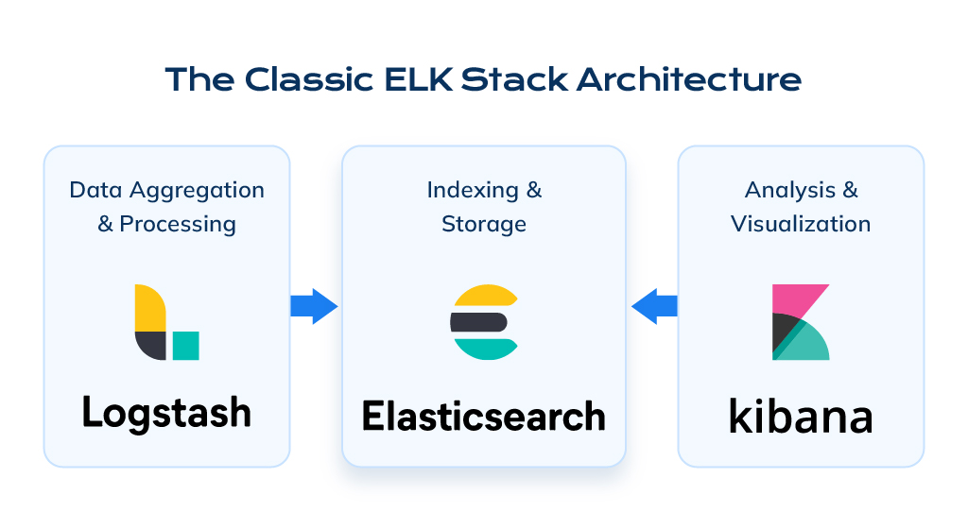
Continuous Monitoring and Logging
Prometheus, Grafana, and ELK Stack
ELK Stack (Elasticsearch, Logstash, Kibana):
Features: Full logging solution with search, storage, and visualization.
Use Case: Collecting and analyzing logs to troubleshoot application issues.
Example: Monitoring and analyzing logs for error patterns to optimize application performance.

Slide 27
Best Practices for Building and Managing DevOps Toolchains
Choose Tools that Integrate Well:
  Opt for tools that seamlessly integrate with the existing workflow to reduce compatibility issues and boost productivity.
Emphasize Automation:
  Prioritize automation in testing, deployment, monitoring, and scaling to enhance efficiency and minimize manual intervention.
Prioritize Security:
  Integrate security tools into the DevOps toolchain (DevSecOps) to secure the pipeline from development to deployment.
Monitor Toolchain Performance:
  Track the effectiveness of each tool and make adjustments to avoid bottlenecks or inefficiencies in the pipeline.
Provide Continuous Training:
  Offer training sessions to keep the team updated on toolchain components, new features, and best practices

Slide 28
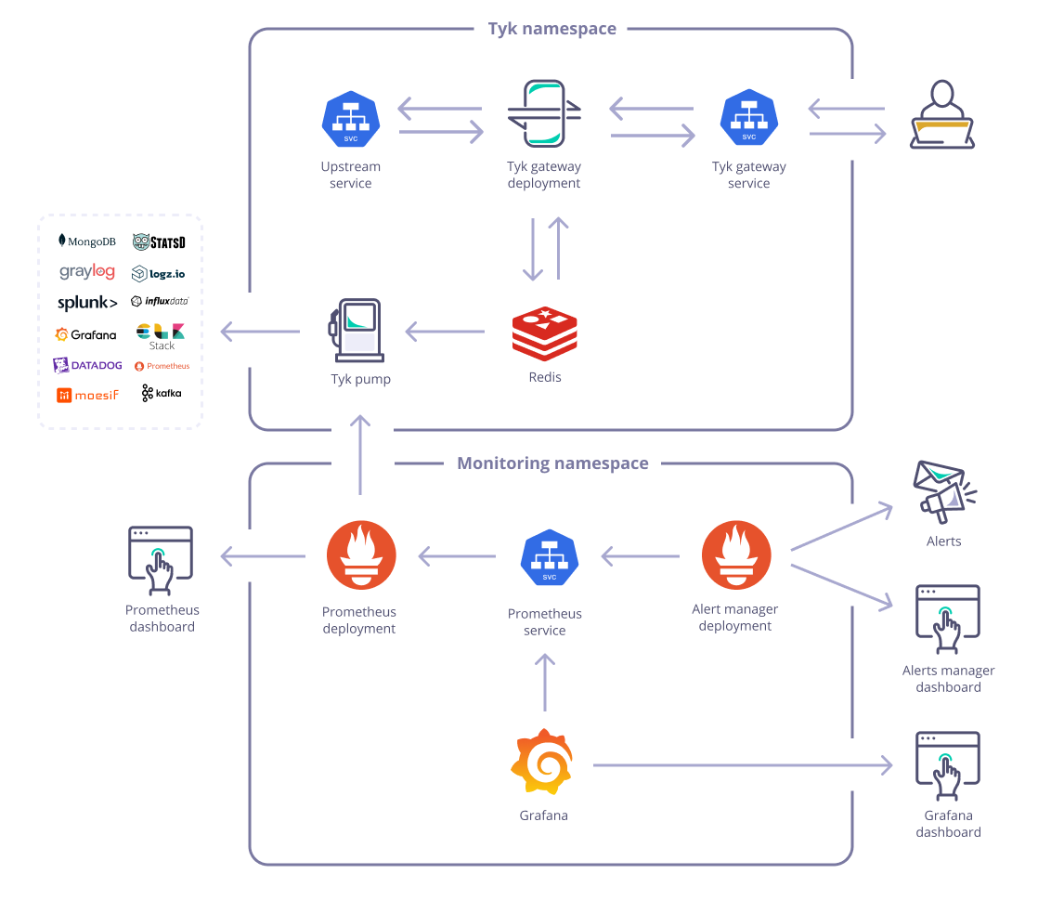
Best Practices for Building and Managing DevOps Toolchains
Using Prometheus, Grafana, and Elk Stack
Prometheus can be used to collect metrics, while ELK focuses on collecting and analyzing logs. Both data types provide different insights:
  Prometheus + Grafana: For metrics monitoring and alerting.
  ELK Stack: For log aggregation, search, and analytics.
Grafana serves as a unified dashboard:
  It connects to Prometheus for metrics.
  It can also connect to Elasticsearch to visualize logs if needed.

Slide 29
References
Kim, G., Debois, P., Willis, J., & Humble, J. (2021). The DevOps Handbook: How to Create World-Class Agility, Reliability, & Security in Technology Organizations (2nd ed.).
Bass, L., Weber, I., & Zhu, L. (2019). DevOps: A Software Architect's Perspective (2nd ed.).

